Slide 1
Git Hub Account

Slide 2
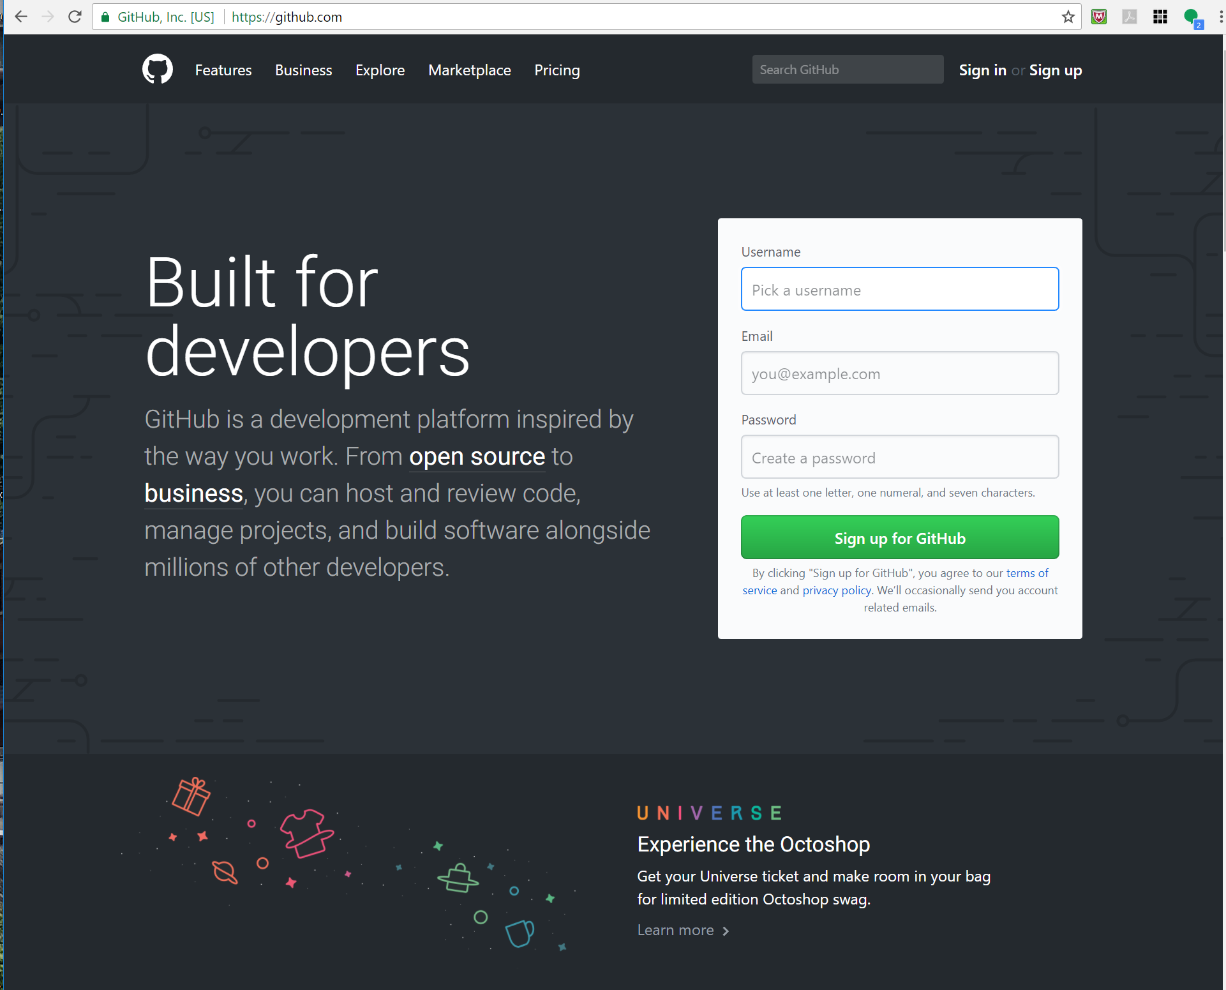
Create Git Hub Account
www.github.com
Fill out the Username, Email and Password.
Once you have an account, send me the email and username used for signup

Slide 3
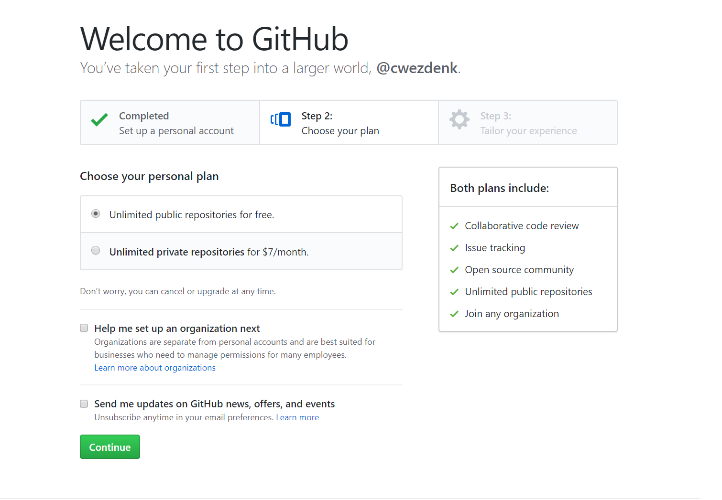
Create Git Hub Account
Choose “Unlimited public repositories for free.”

Slide 4
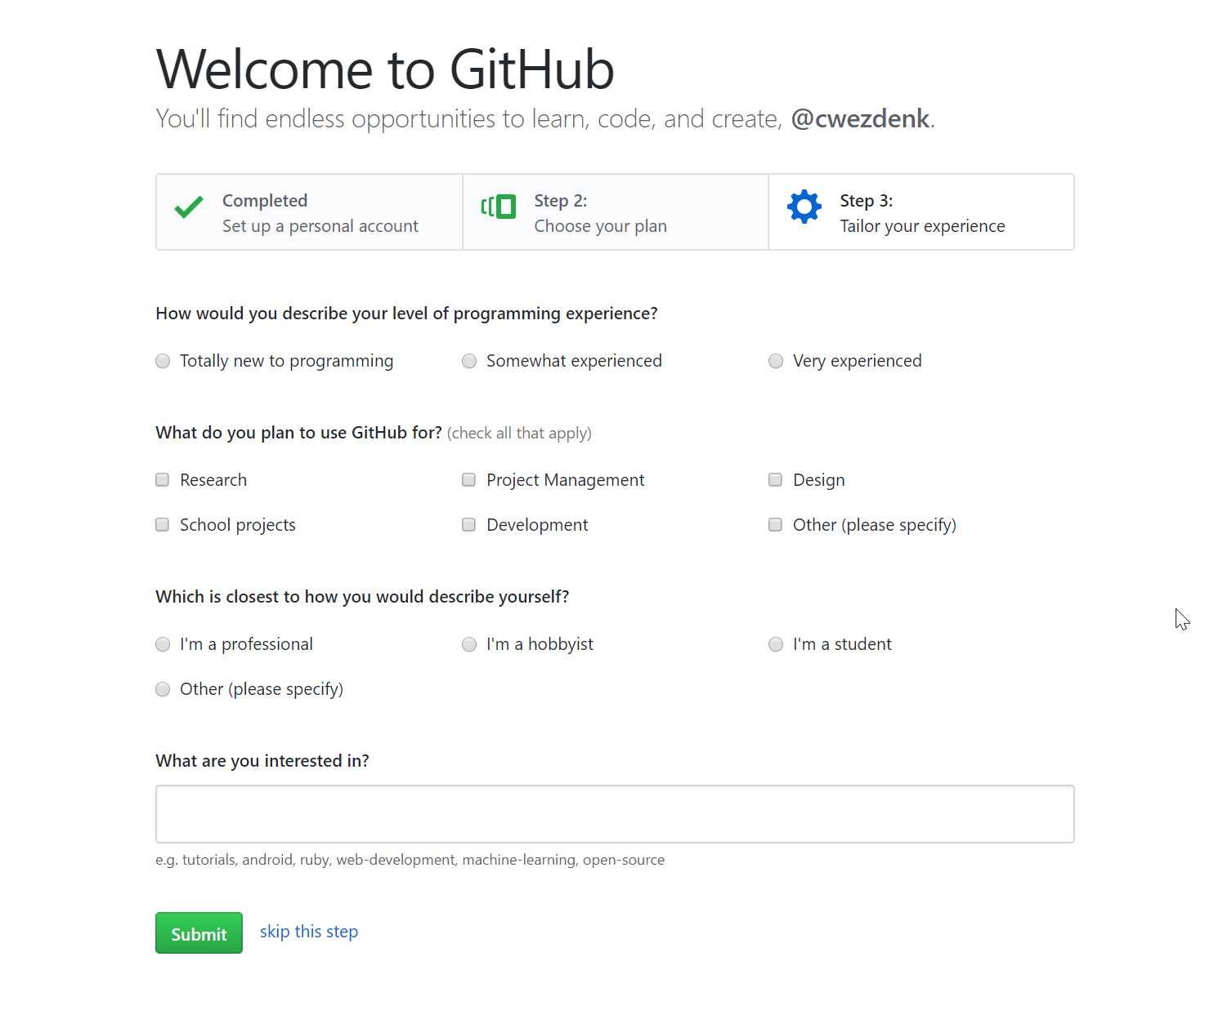
Create Git Hub Account
I normally skip this step on this page.

Slide 5
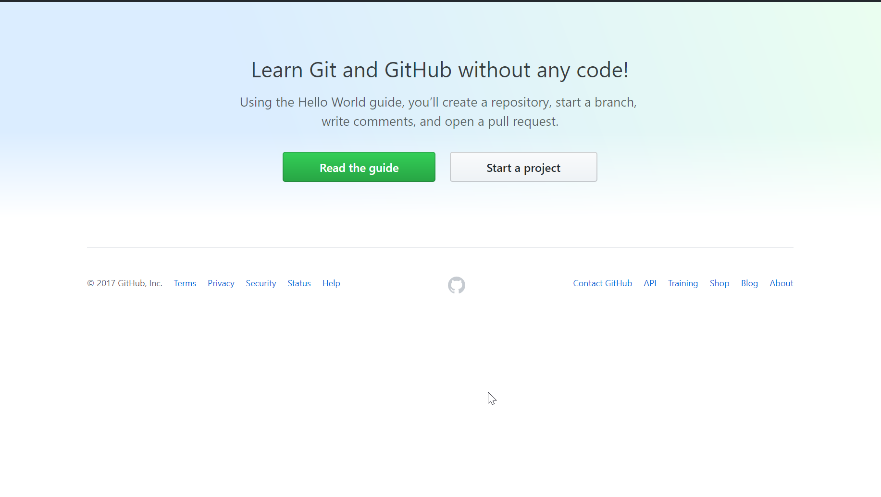
Create Git Hub Account
Should see this now
You will get an email to verify your account

Slide 6
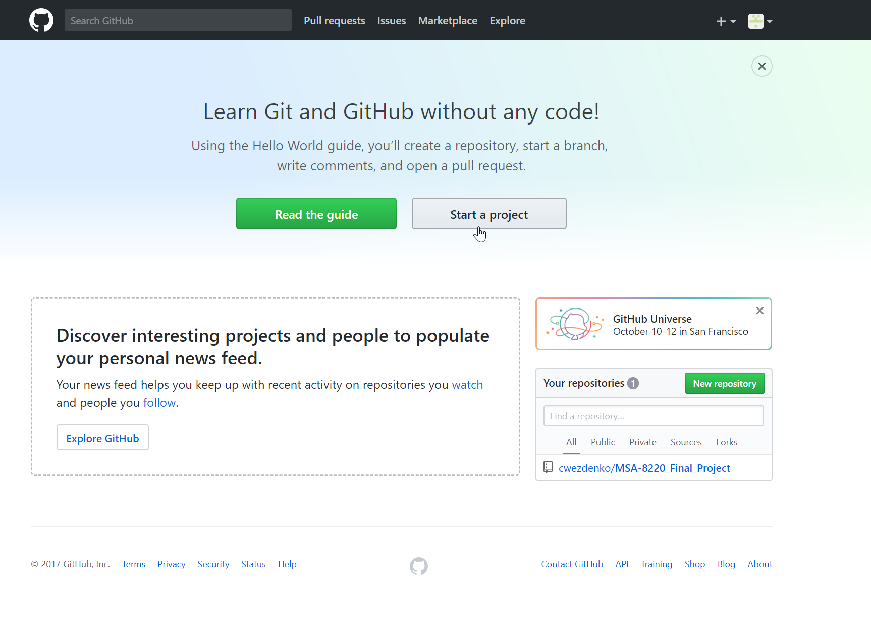
Adding the MSA-8220_Final_Project to you profile
With you email and username, I will add you as a contributor to the project.
When you receive the email, click the link to accept the invitation.
Once the invitation is accepted, the project will show up under “Your Repositories”

Slide 7
Accessing and saving the files
You can use the web interface to access the files and upload changes, but the desktop app is much easier
https://desktop.github.com/
Download the app (windows or mac)

Slide 8
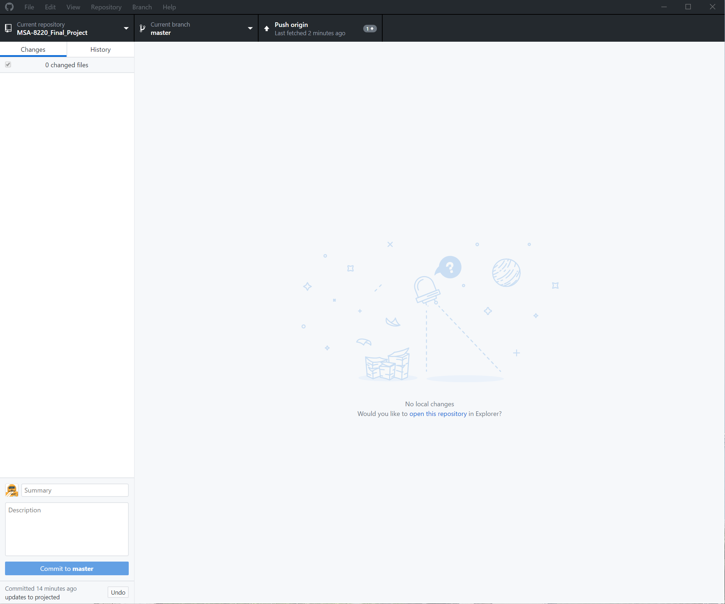
GitHub Desktop
Once installed, the app will look like this:

